Slide 1
A field and laboratory exercise that studies the relationship between Dalmatian
toadflax and its biological control agent, the stem weevil.
Field data collection
a) estimate stem density of toadflax at one or more sites.
b) collect a sample of stems of toadflax from one or more sites
Lab work
1. Carefully measure 20 cm sections of toadflax stems (note: if lots of egg scars,
use only 10 cm. Cut the stems to this length.
Count egg scars (see 4th PPT slide) per unit of stem.
Carefully dissect the stem and see how many weevils you can find.
Class effort
Graph class results: numbers of weevils found versus number of egg scars.
Compare your egg scar average to that found on the Front Range, 2010-
2013. How does your site compare?
3) Based on your numbers and graph of relationship between egg scars and
plant reproduction (5th PPT slide), how healthy is your population of
toadflax?

Slide 2
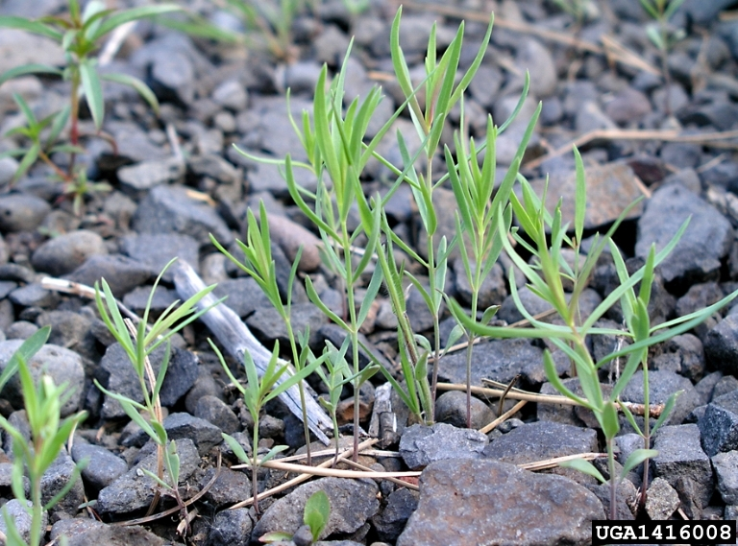
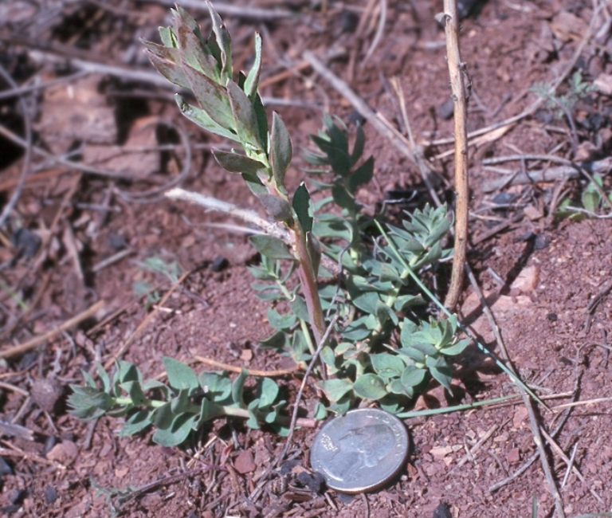
Toadflax Life Cycle
1 mm
Seed
5 cm
Seedling
Adult
Rosette

Slide 3
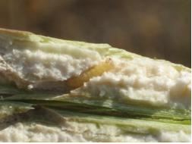
Interaction: Weevils and Toadflax
Egg
~5 mm
~5 mm
1 mm
Seed
Larva
5 cm
Seedling
Adult
Adult
~5 mm
Rosette
Pupa
Weevils develop in the stems. Can the weevil control the plant?

Slide 4
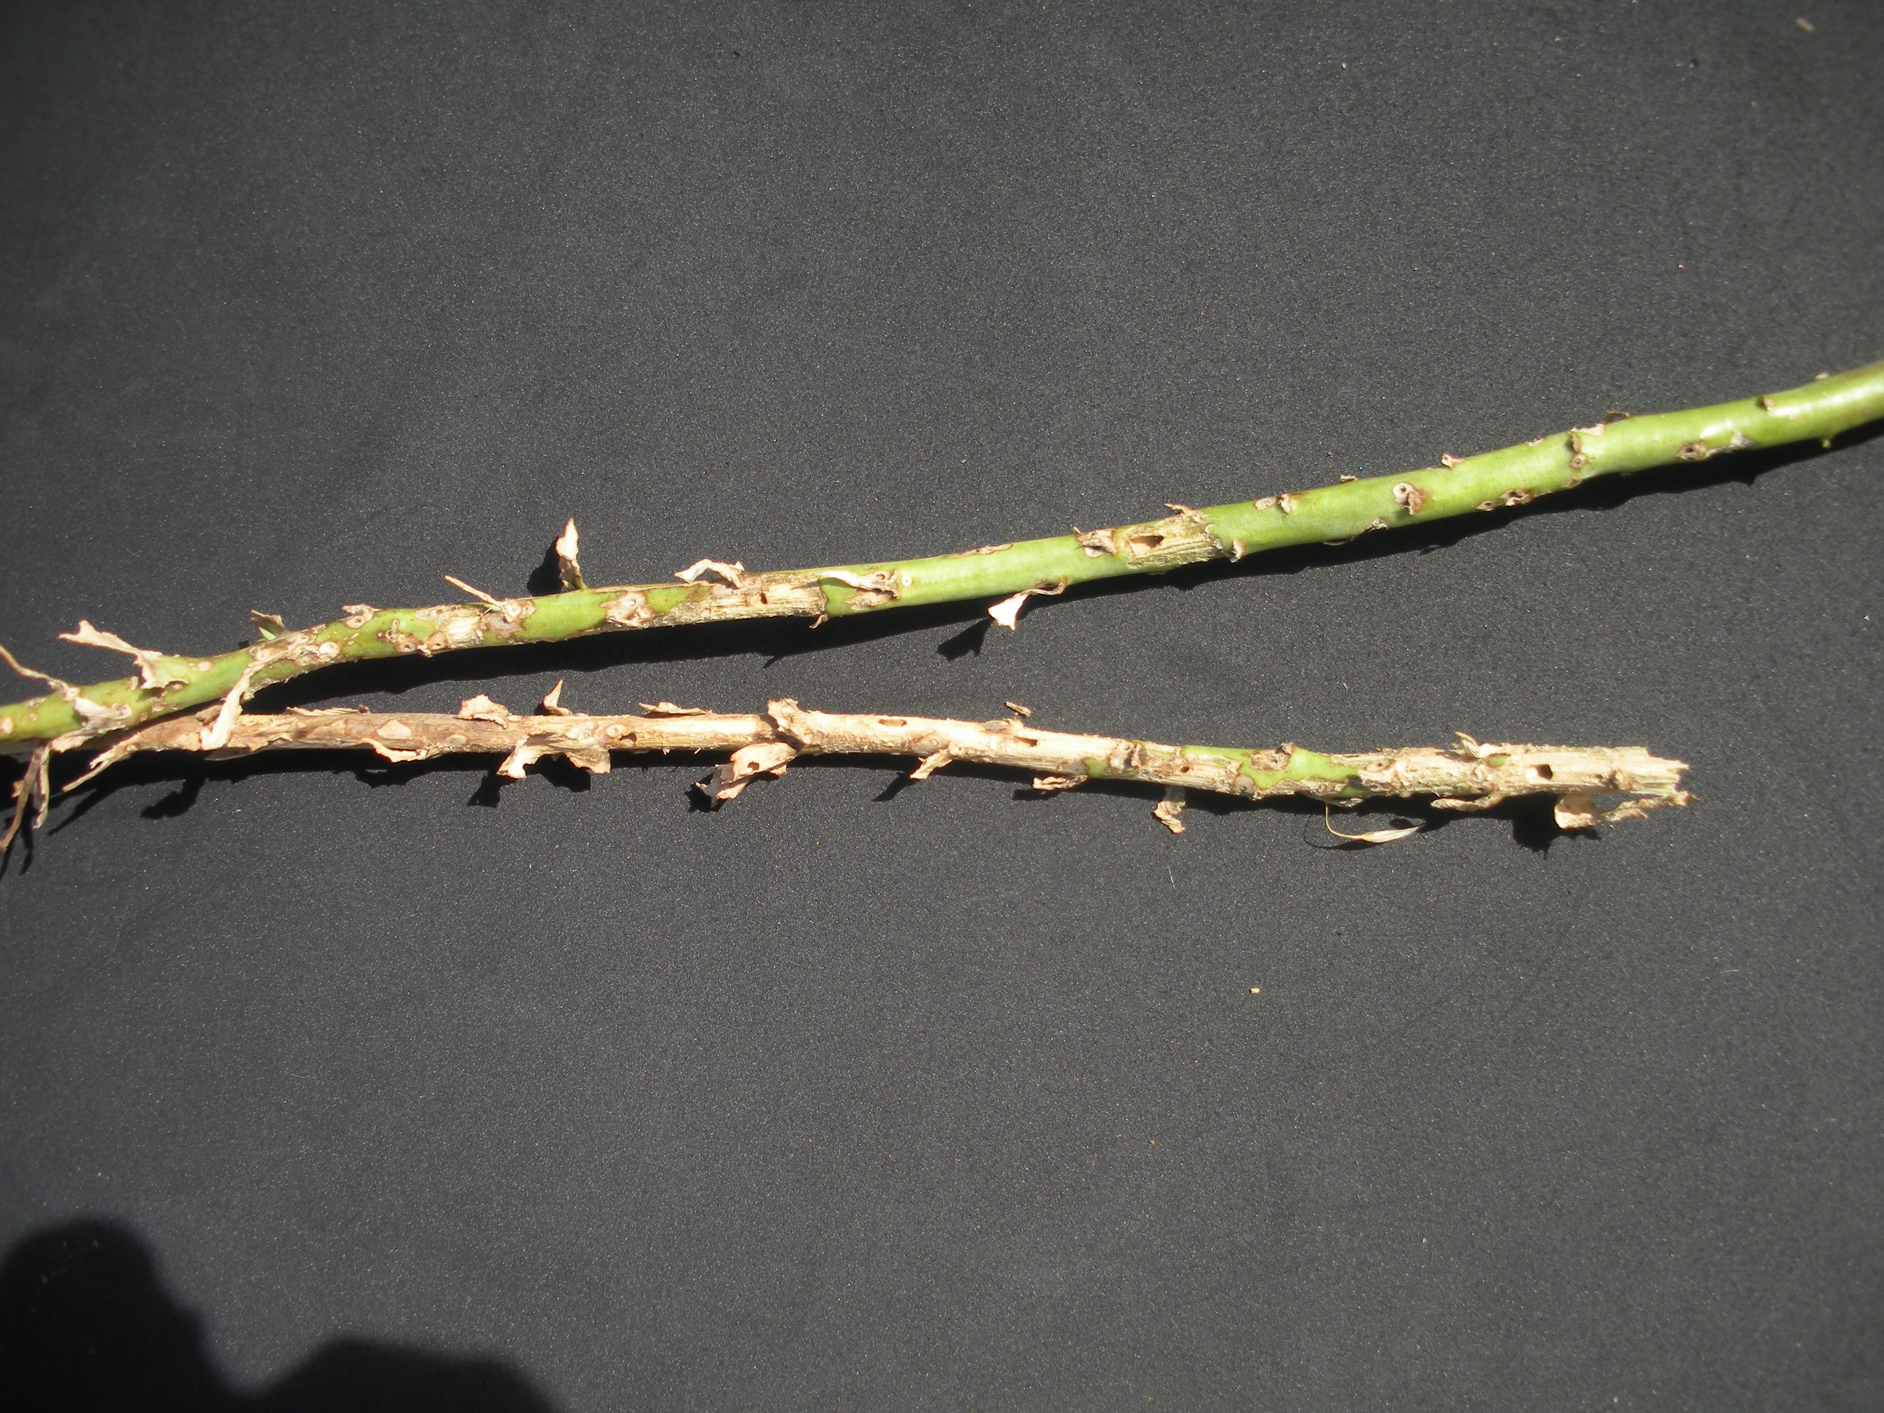
The small pinholes in the toadflax stems are egg scars (sites where
females laid their eggs that subsequently
burrowed into the stem.)
The larger holes are where adult weevils likely
emerged(this stem was collected in late August, two months
after egg-laying)

Slide 5
Eggs laid per centimeter of stem on Dalmatian toadflax
(results from five sites found along Colorado Front Range)
Egg scars per cm of stem
2011 2012 2013
Year

Slide 6
Effects of stem weevils on plant reproduction
Flowers or pods per stem
Number of egg scars per cm of stem

