Slide 1
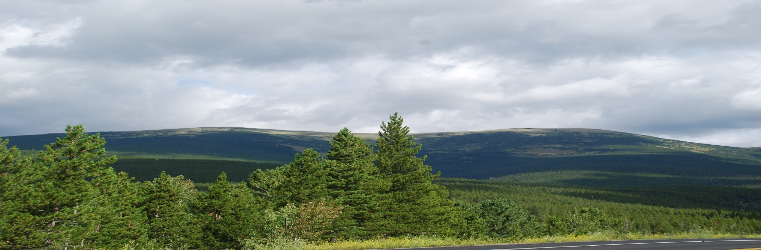
Virtual Thistle and Weevil Field Trip at
CU Mountain Research Station
View of research station from Peak to Peak Highway

Slide 2
The Mountain Research Station
The Mountain Research Station (MRS) is an interdisciplinary research facility of the Institute of Arctic and Alpine Research, University of Colorado, devoted to advancement of study of mountain ecosystems.
Our mission is to facilitate research and education to better understand the unique patterns and processes of biotic and physical systems in mountains, and how environmental changes may influence these patterns and processes. (http://www.colorado.edu/mrs/general-information)

Slide 3
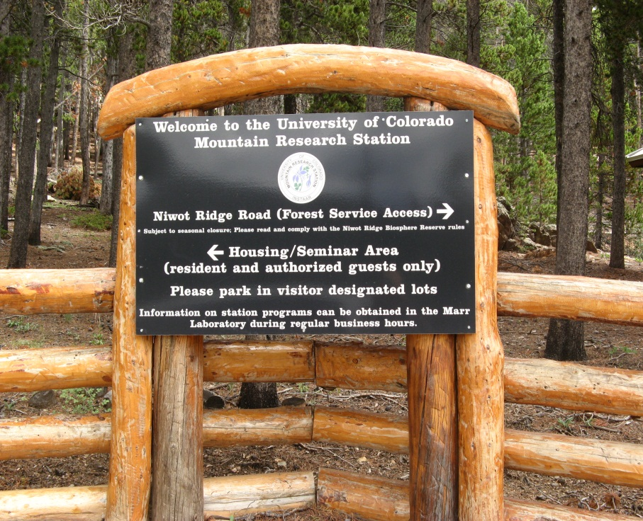
Setting and Ecosystem
Our focus for our field trip will be a meadow and riparian area located at 9,700 feet located at the lower end in elevation subalpine ecosystem which extends up to 11,000 feet.

Slide 4
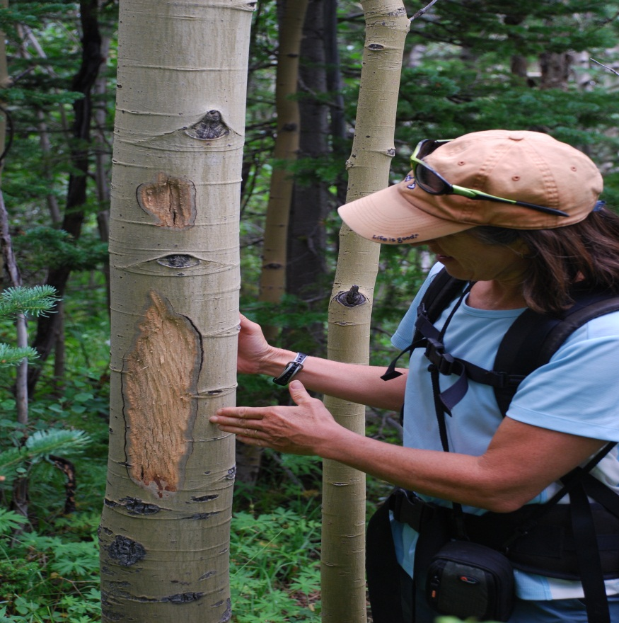
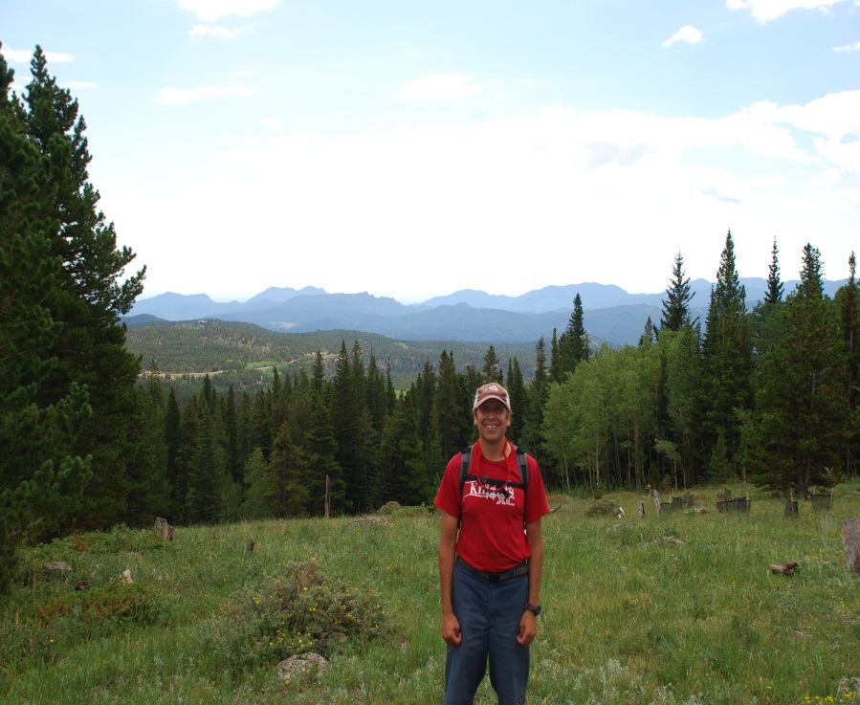
Your Leaders
DT
Ms. Greene

Slide 5
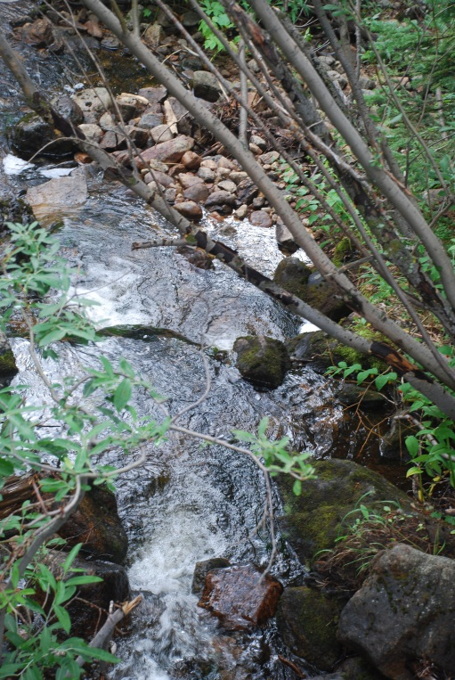
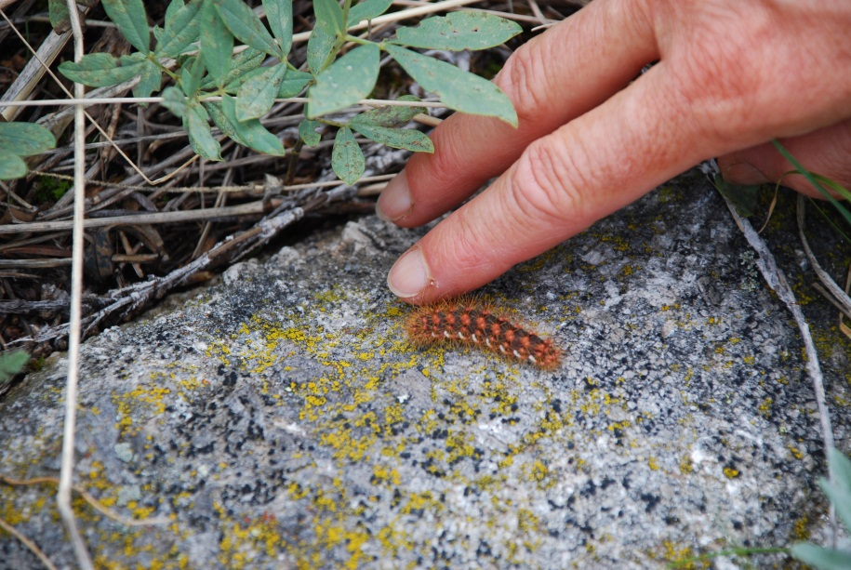
Ecosystems are made up of the living (biotic) and non-living (abiotic)
biotic
abiotic

Slide 6
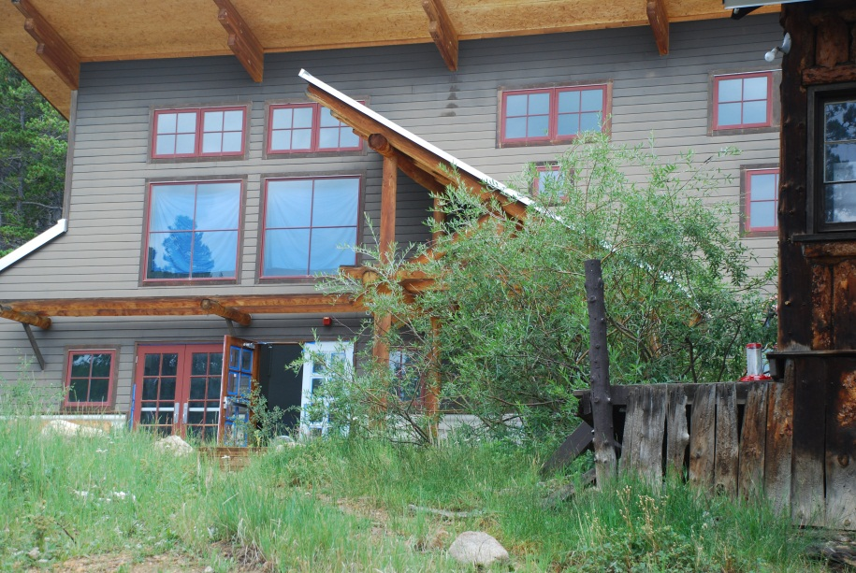
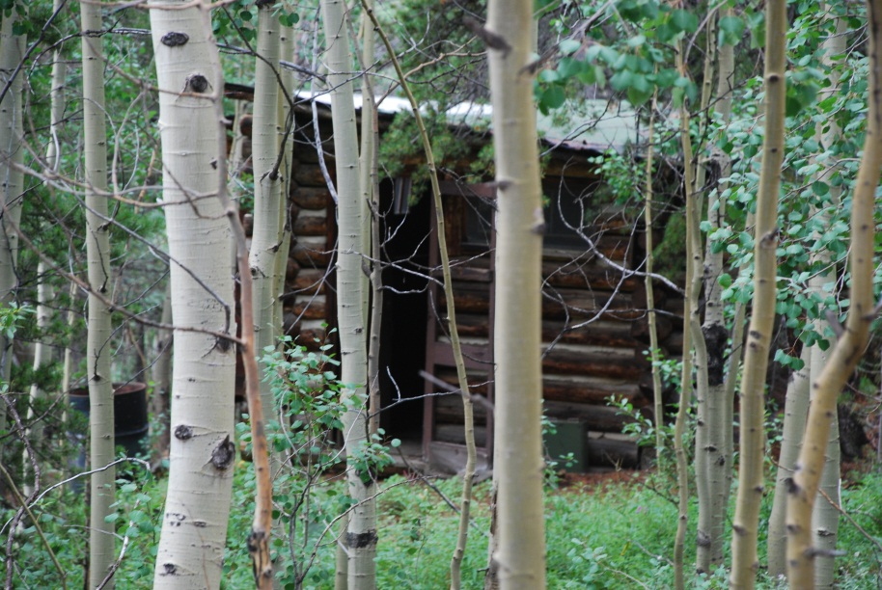
Mountain Research Station Human Homes
Moores-Collins Family Lodge
cabin

Slide 7
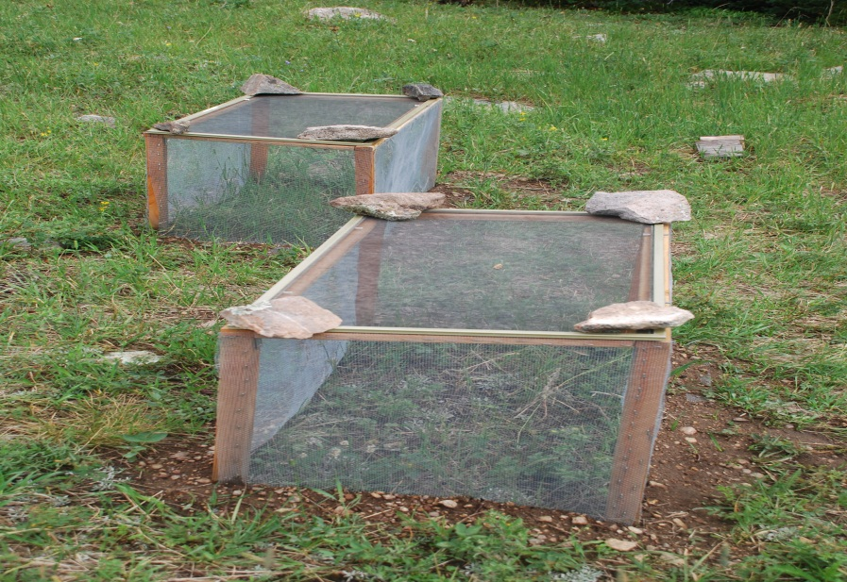
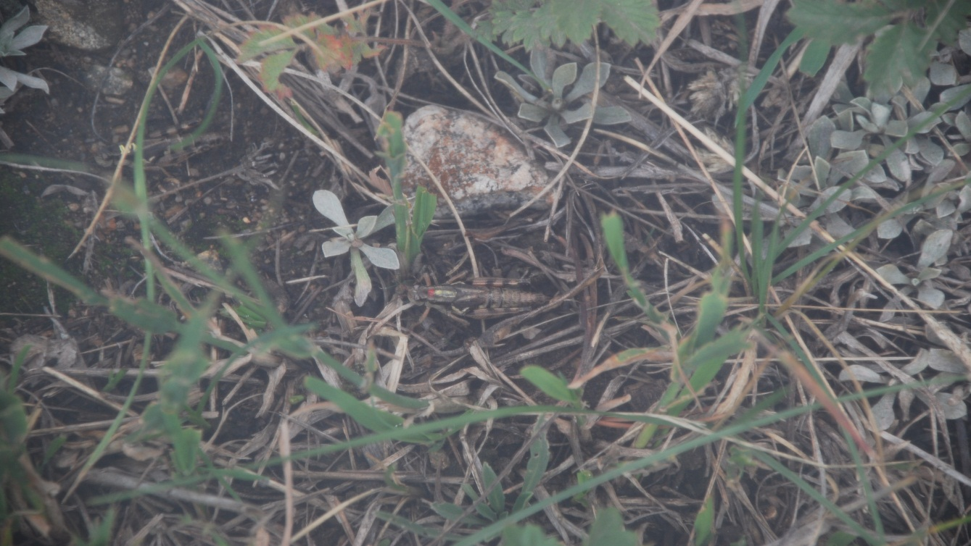
Animals have homes too…
The photo to the left shows the home of a grasshopper pair being studied to show their affects on the meadow.

Slide 8
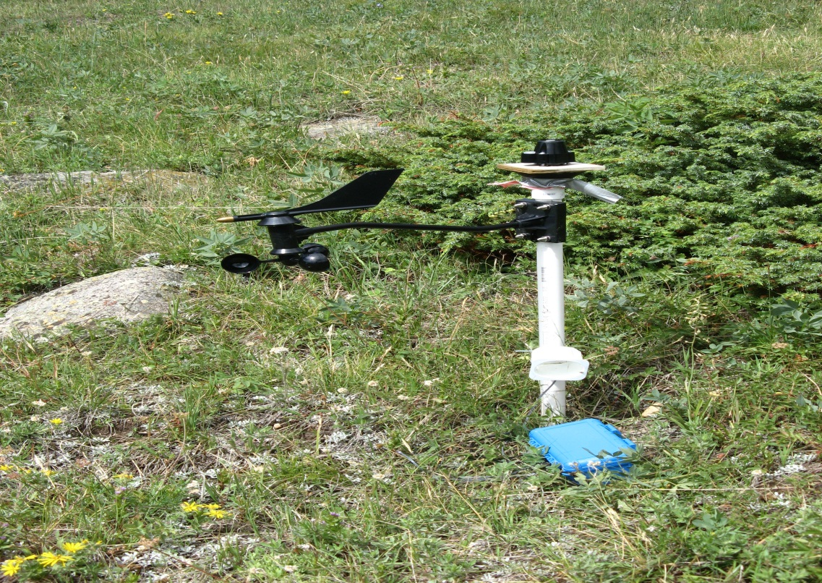
The weather station
This station monitors a lot of the abiotic factors affecting the meadow. They even have thermometers in the soil. What abiotic factors might scientists be
studying here?

Slide 9
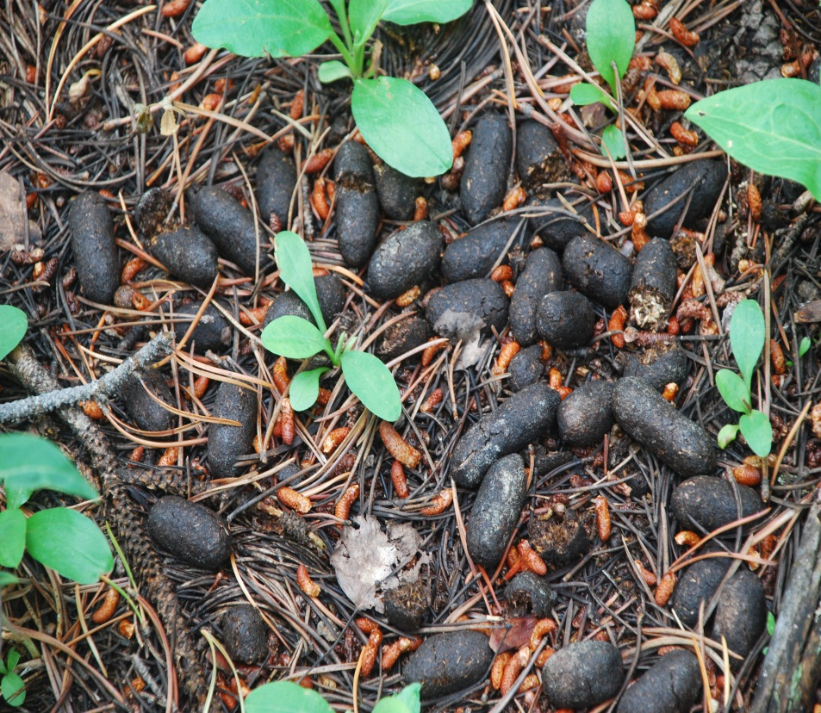
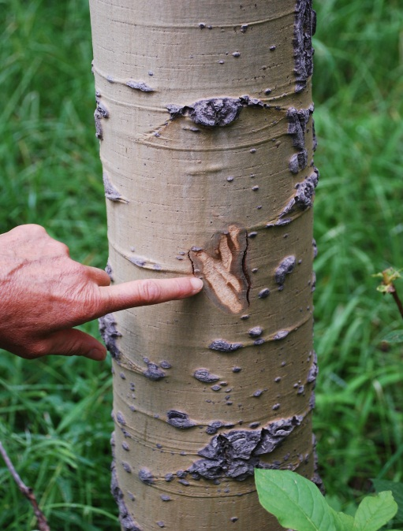
Some animals live here and leave signs of their presence…
Elk
Moose droppings
A chew made when forage is covered with snow the bark has some nutrients.

Slide 10
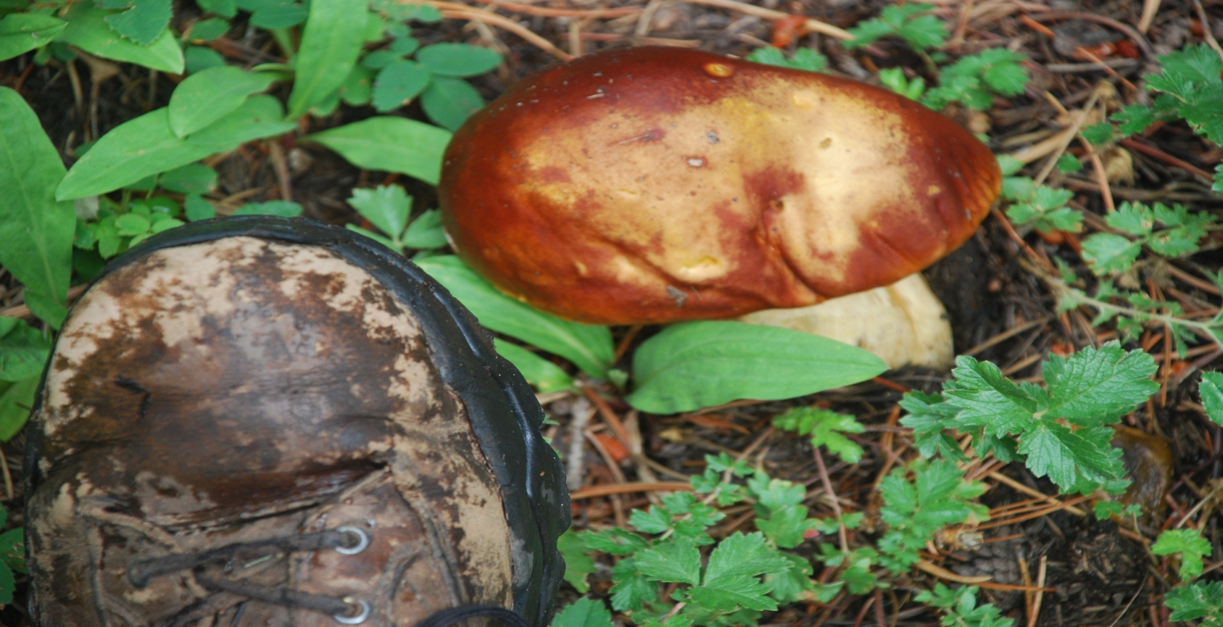
To bring the abiotic nutrients back to the soil there are…
decomposers, mushrooms.

Slide 11
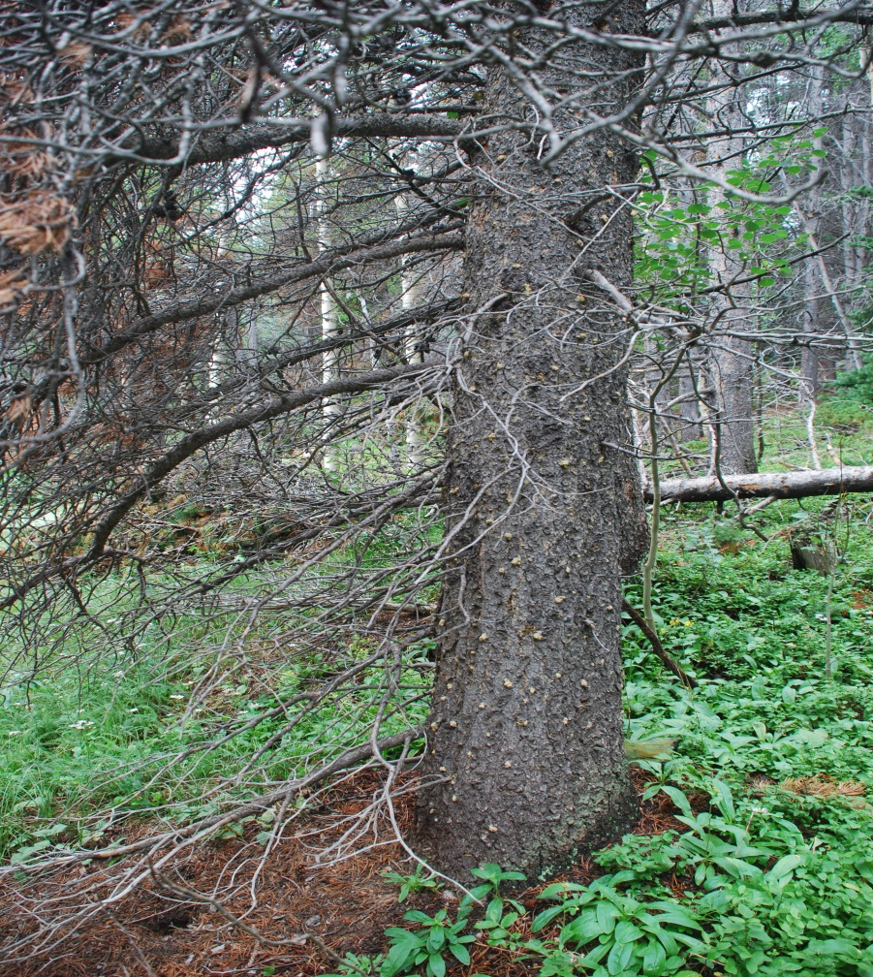
Some animal homes may not help their hosts
This tree may have been killed by the mountain pine beetle

Slide 12
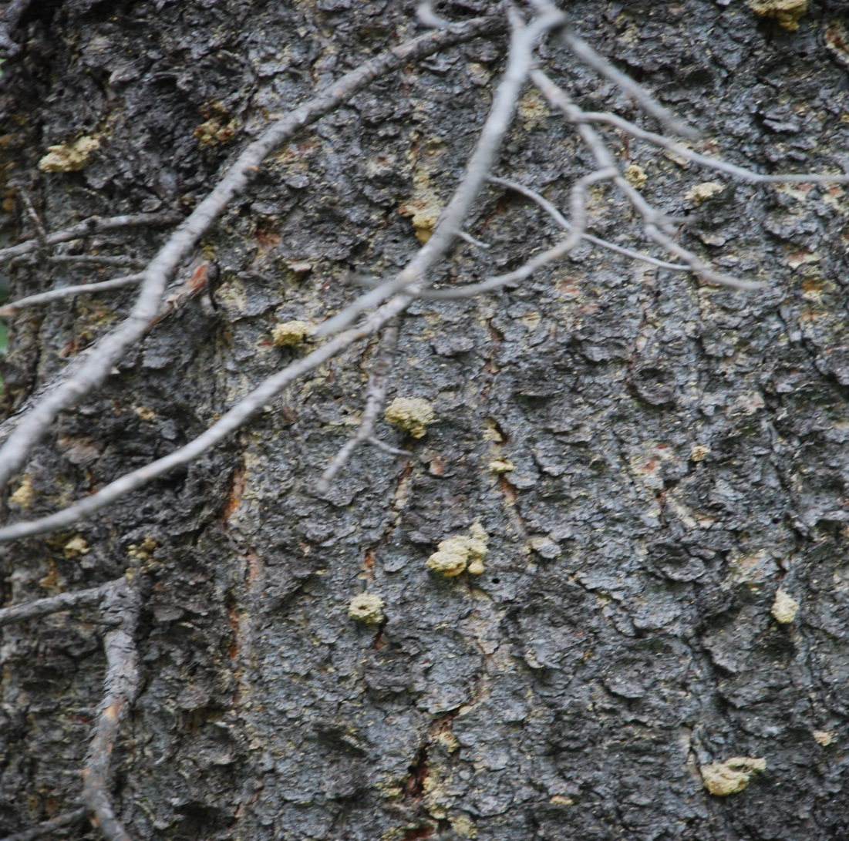
Exit holes of the adult are present upon close inspection

Slide 13
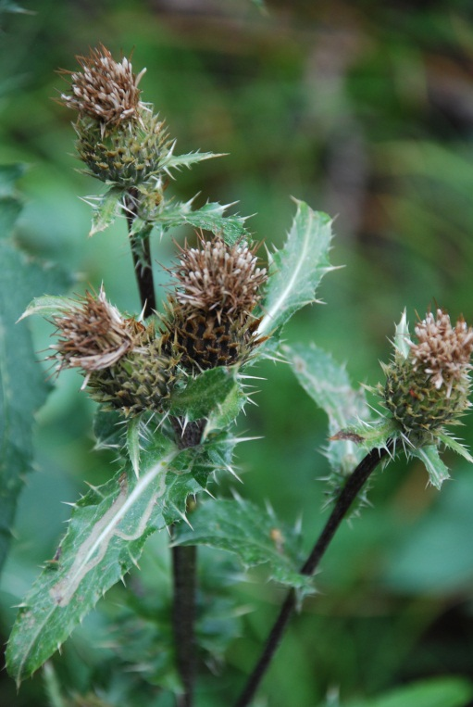
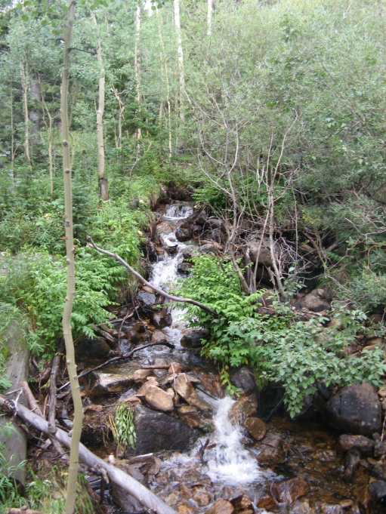
Our purpose is twofold:
To learn about Colorado’s alpine ecosystems.
To focus on how one animal: a beetle, may affect a plant.

Slide 14
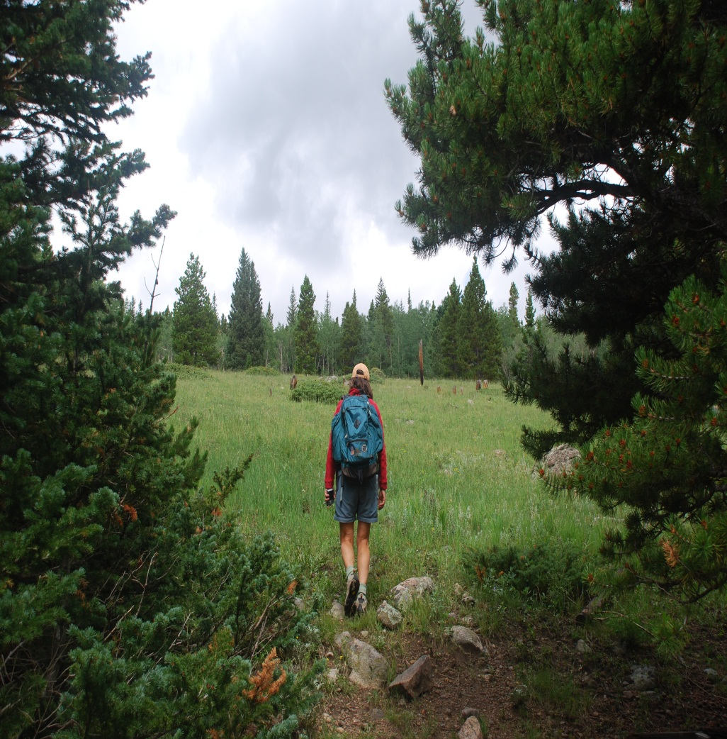
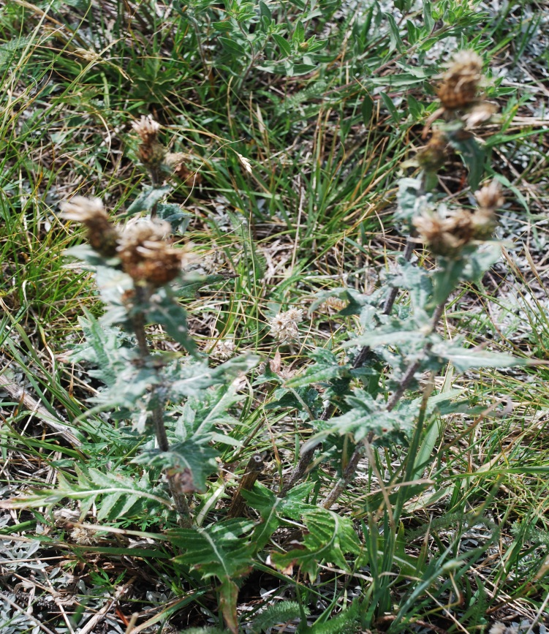
This thistle is a native part of the meadow
An adult thistle plant.

Slide 15
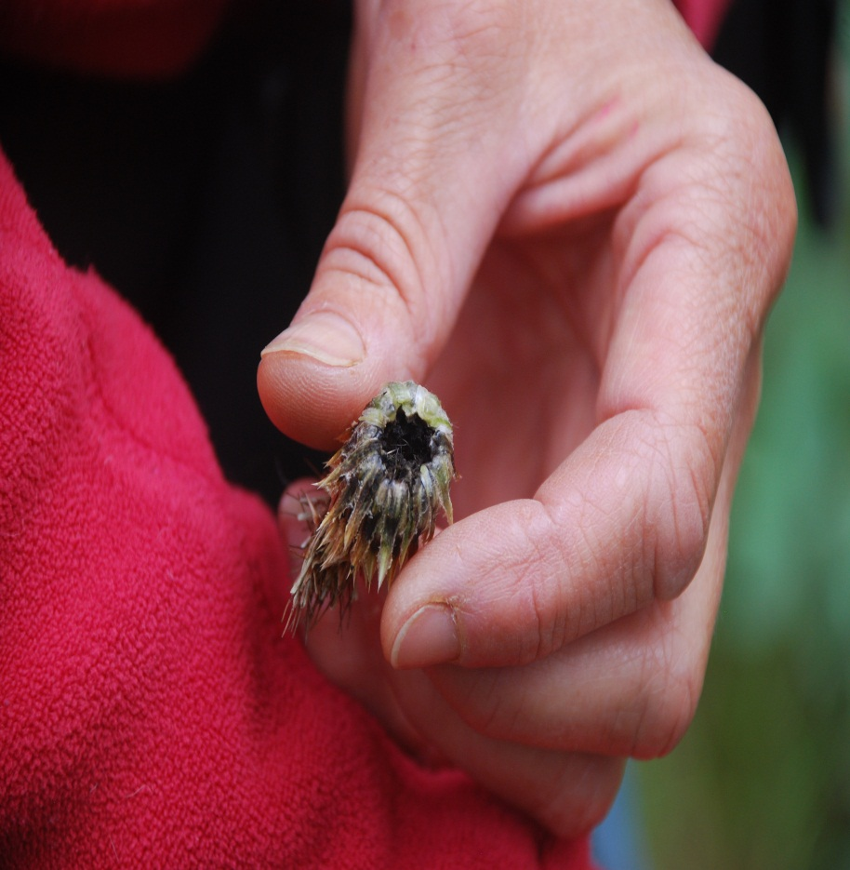
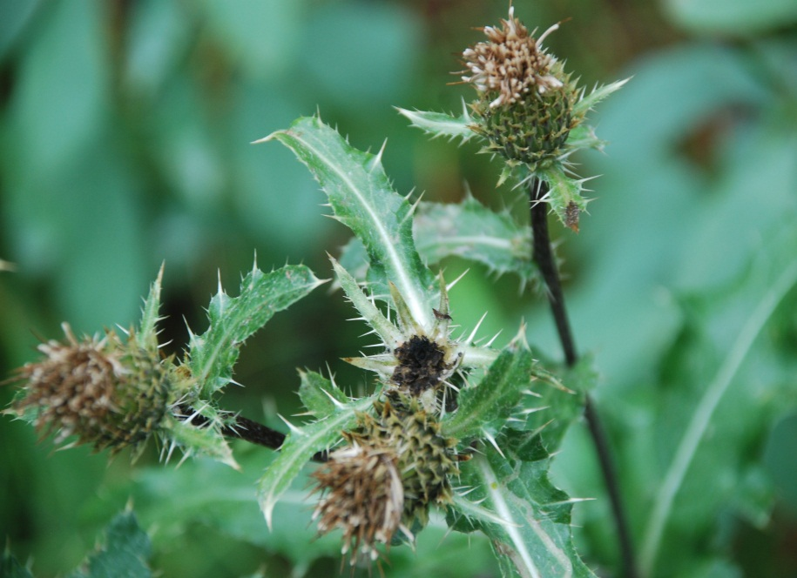
Native fringed thistle: Cirsium centaureae
A non-native introduced beetle, a weevil, has started to lay its eggs on this thistle.
For as long as scientists have studied local plants, this thistle has been in Colorado.

Slide 16
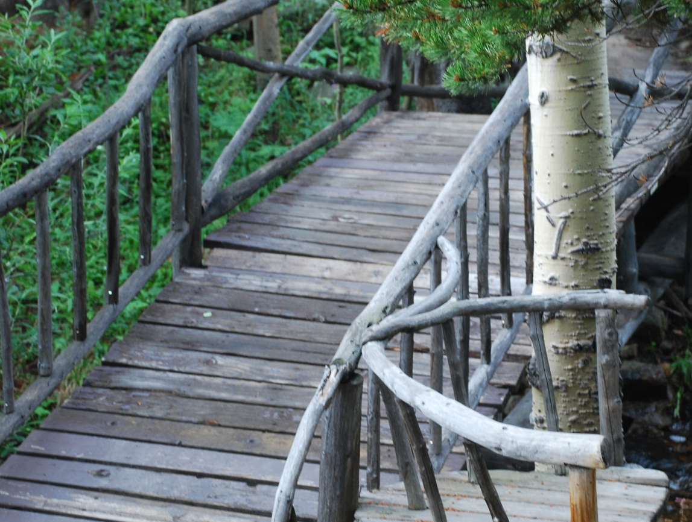
How is the weevil affecting the native thistle plant?
Our job is to help CU scientist, Tim Seastedt, collect data that will help answer this question.

Slide 17
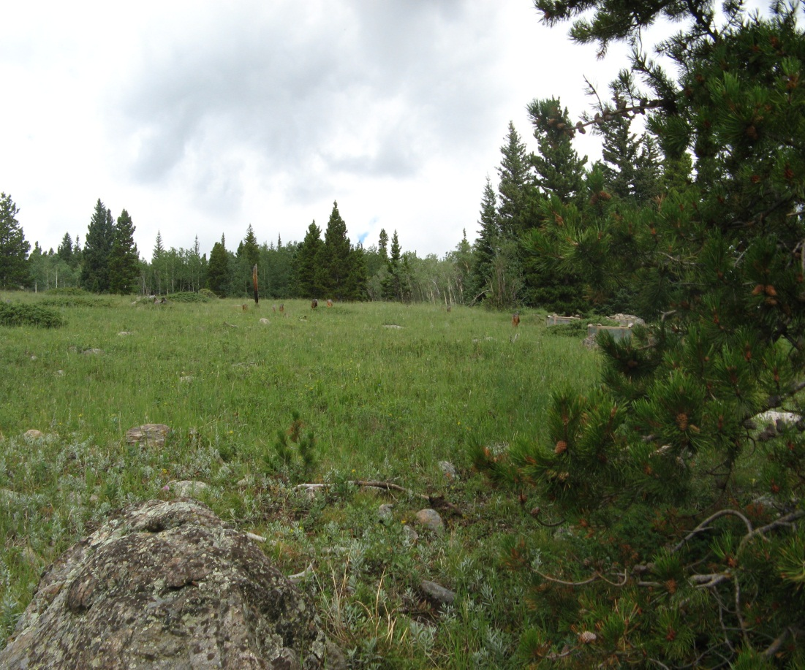
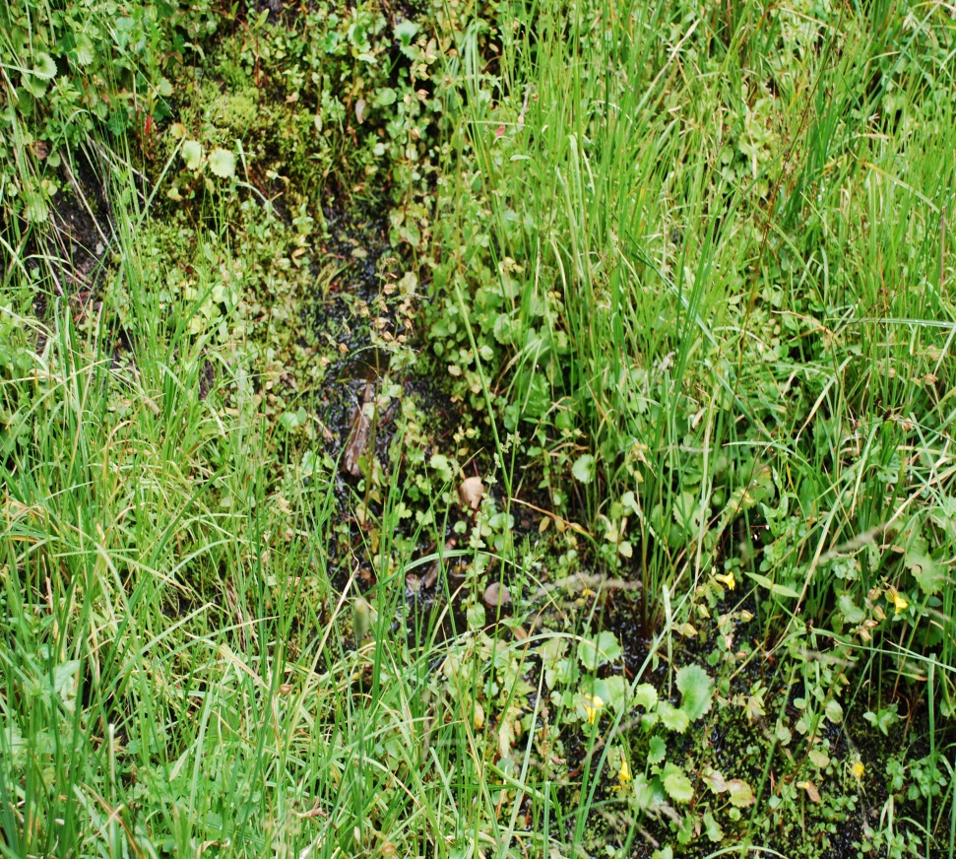
Student Scientists will collect plants.
From the meadow
From the adjacent riparian area

Slide 18
What questions need to be answered about the native thistle and the non- native weevil?
For example, what is the relationship between the weevil life cycle and the thistle life cycle?
Brainstorm other questions that could be investigated.

Slide 19
One thing scientists typically do is a review of the prior work at the site or on the topic.
This can be a literature review
Or past work at the specific site
Bradley, BM. Oppenheimer M, Wilcove D (2009) Cimate change and plant invasions: restoration opportunities ahead? Global Change Biol. 15: 1511-1521.
Bowman WD, Seastedt TR (eds) (2001) Stucture and function of an alpine ecosystem: Niwot Ridge, Colorado. Oxford Press, NY
Culliney TW (2005) Benefits of classical biological control for managing invasive plants. Critl Rev Plant Sci. 24: 131-150.
Erickson O (1996) Regional Dynamics of Plants: A Review of Evidence for Remnant, Source-Sink and metapopulations. Oikos 77: 248-258.
Guretzky JA, Louda, SM (1997) Evidence for natural biological control: Insects decrease survival and growth of a native thistle. Ecol. Appl. 7: 1330-1340.
Lenoir J, Gégout JC, Marquet PA, de Ruffray P, Brisse, H. (2008) A significant Upward shift in Plant Species Optimum Elevation During the 20th Century. Science 320 1768-1771.
Liptzin D (2007) Soil nutrients and biogeochemical cycling at the forest – alpine tundra ecotone. Dissertation, University of Colorado, Boulder.
Louda SM (1998) Population growth of Rhinocyllus conicus on two species of native thistles in Prairie. Environ Entomol 27: 834-841.
Louda SM, Arnett, AE (2003). Invasiveness of some biological control insects and adequacy of their ecological risk assessment and regulation. Cons Biol 17: 73-82.
Factors influencing use of the native thistle, Cirsium centaureae, by the introduced weevil, Rhinocyllus conicus
By Alyssa Carlson

Slide 20
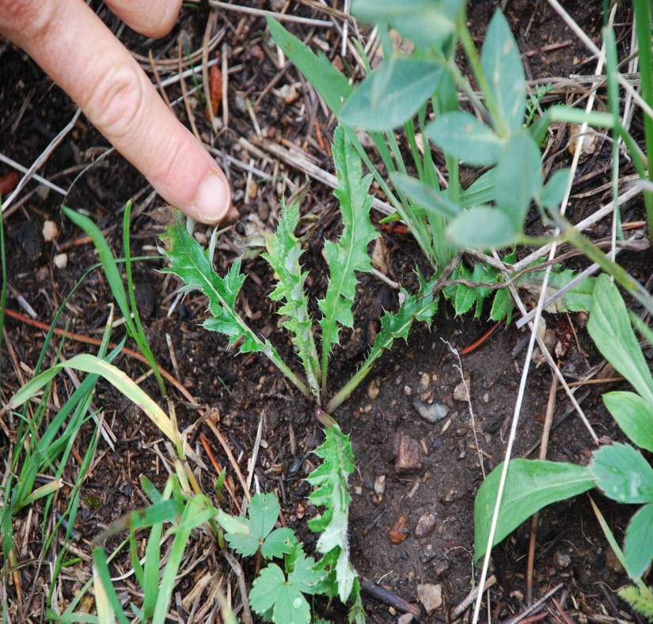
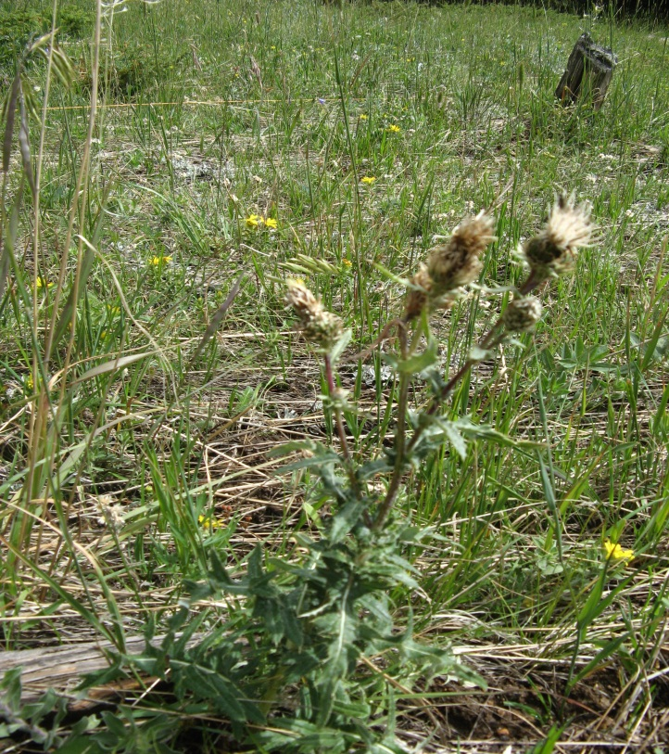
The following slides by Alyssa Carlson, who worked at the site, will give you some background information.
In the first year, the thistle makes a rosette.
In the second year, the thistle flowers.

Slide 21
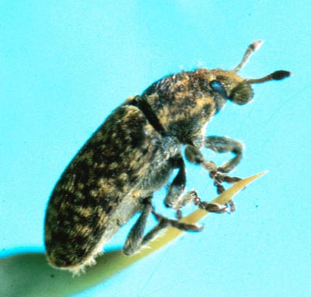
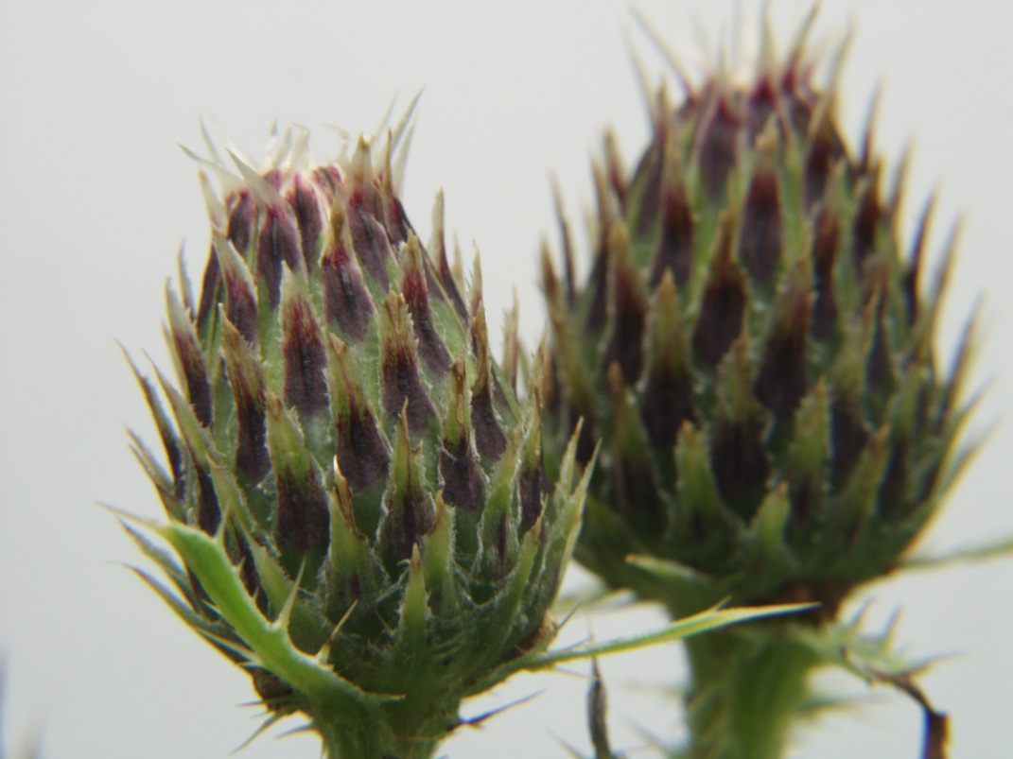
Factors influencing use of the native thistle, Cirsium centaureae, by the introduced weevil, Rhinocyllus conicus
Agriculture & Agri-Food Canada
Alyssa Carlson
Anthony Darrouzet-Nardi

Slide 22
Background Information and History

Slide 23
Time Line of Thistle and Weevil Introduction
1600’s: Canada thistle introduced (PCA, 2004)
1800’s: Musk thistle introduced (PCA, 2004)
1969: First release in the United States of weevil, Rhinocyllus conicus as a biocontrol of musk thistle (Kok, 2004)
1980’s & 1990’s: Researchers begin finding R. conicus on native, non-target thistle species (Arnett & Louda , 2002; Louda, 1998; Louda, et al., 2003; Louda, 2003; Louda, et al., 2003; Turner, et al., 1987)
2002: R. conicus uses about a 3rd of native thistles (Louda, 2002)

Slide 24
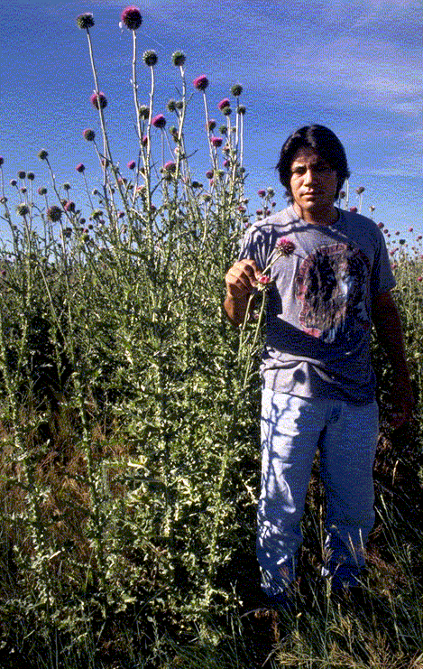
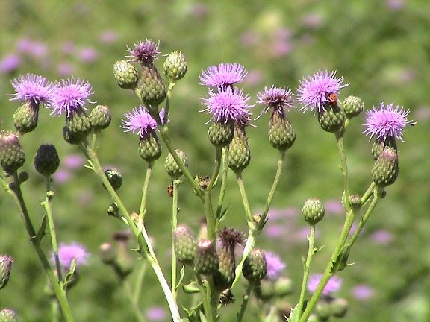
Non-native Thistles
Musk Thistle
Canada Thistle

Slide 25
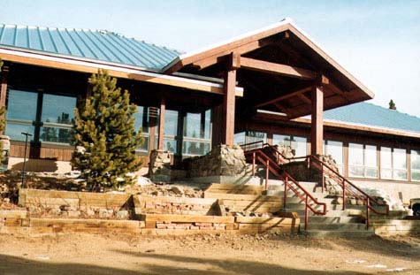
At the Mountain Research Station
Native thistle species: Cirsium centaureae
Non-native weevil species: Rhinocyllus conicus
Both found in Elk Meadows and adjacent riparian zone
No non-native thistles currently found in Elk Meadows
MRS website
Canada thistle located around John Marr Lab and lower in elevation roughly a mile away from the station

Slide 26
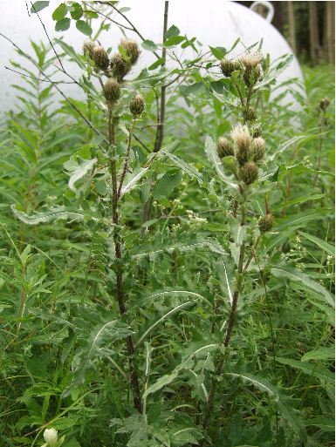
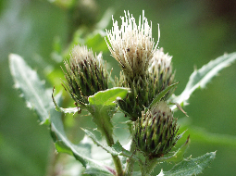
Fringed Thistle, Cirsium centaureae
Native to Colorado
Member of the Aster family
Flowers in small clusters; normally about 3-5, but can be alone as well
White flowers (sometimes a light purple)
Montane to subalpine
New habitat for weevils
Anthony Darrouzet-Nardi

Slide 27
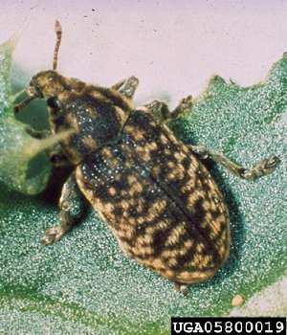
Weevil, Rhinocyllus conicus
Non-native weevil
Seed head weevil
Native range: Eurasia
Released in America as a biocontrol for Musk thistle
Since moved on to other thistles
Agriculture and Agri-Food Canada

Slide 28
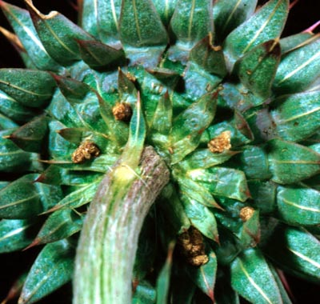
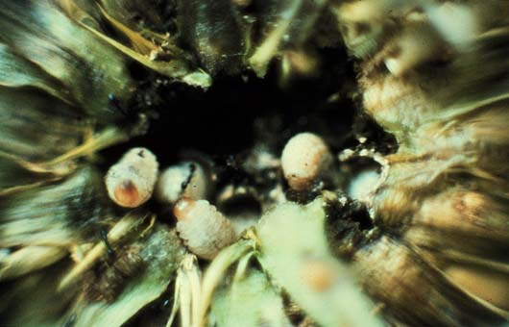
Life History of Weevil,R. conicus
Agriculture & Agri-Food Canada
Adults over winter in the soil (Smith and Kok, 1987)
Emerge in the spring
Feed on the stems of thistles
Ova deposits in seed heads
Larvae develop within seed head and feed upon the seeds
Dr. L.T. Kok

Slide 29
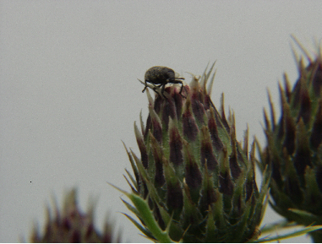
Weevil, R. Conicus at MRS
R. conicus has been found on C. centaureae in the Elk Meadows and the riparian zone
What does this mean for the native thistle?

Slide 30
Questions
Is the weevil eating seed heads of the native fringed thistle?
If so, is there a difference between weevil seed consumption between the meadow and the riparian zone thistles?

Slide 31
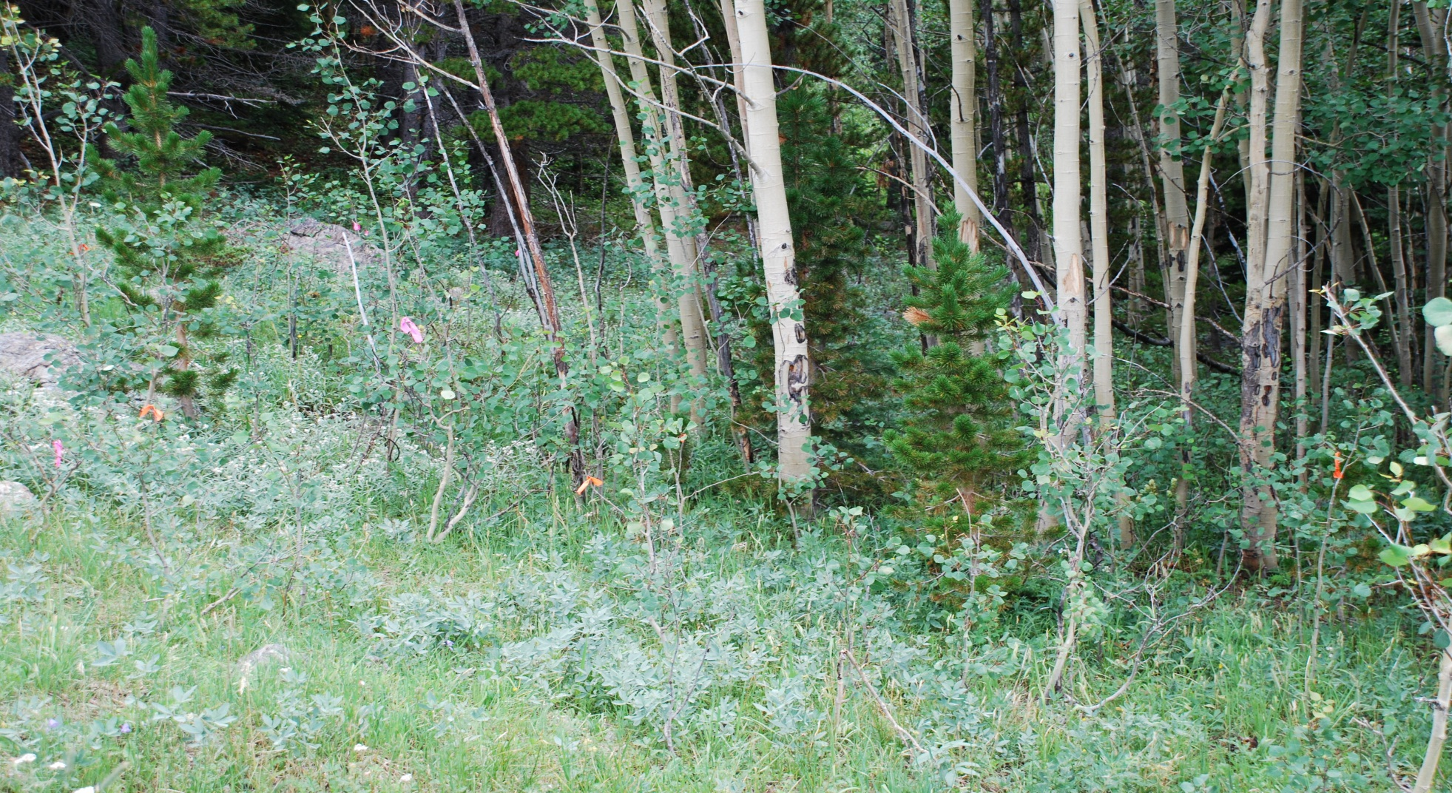
Design an experiment to answer these two questions

