Slide 1
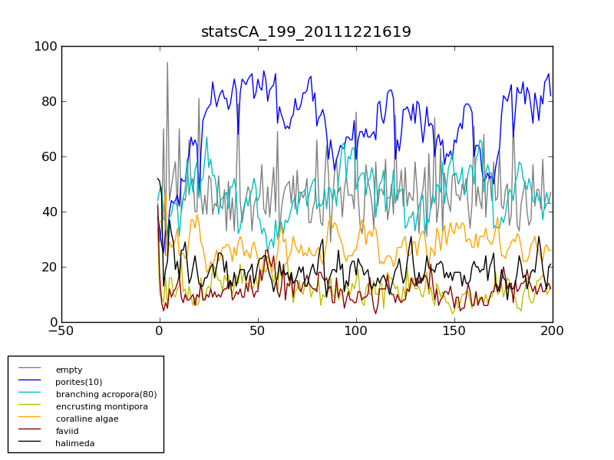
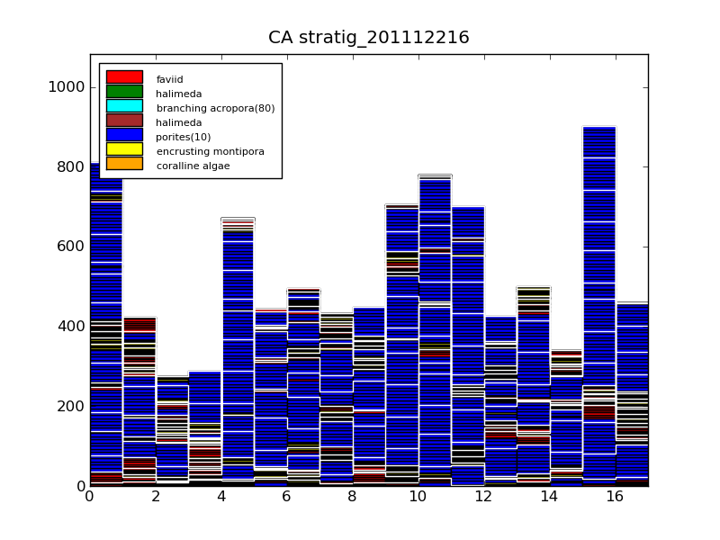
23Jan2011 status for carbo:
Longevity mortality, spawning, competition are now implemented (or improved)
Program is running faster (attention to IF statements)
Facies and events are now entered via separate configuration files
Note spin-up
Cell count
years
carboCAT is Peter’s Cellular automaton, carboPOP is Chris’ stochastic Cellular model
In the Python they share code and visuals
Thickness (mm)
Cells across map

