Slide 1
Run of new version: pyCarboCAT_4_5.py 28 Dec 2010
Chris Jenkins, INSTAAR

Slide 2
The Cellular Model applies to areas of order 100-1000m.
Chrons are now showing on the thickness diagrams
Crushability of the various organisms now scaled into accumulation (eg Acropora disintegrates, Porites does not)
Better clearing of graphics memory buffers (=> longer runs possible)

Slide 3
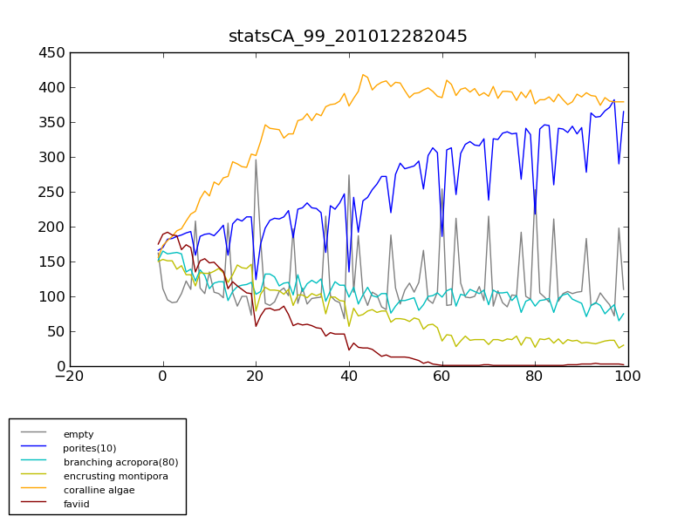
Live cover values (as CellularModel cell counts) over 100 years with many “disasters” hitting the site. Calcareous algae and Porites gradually gain dominance.
Empty seabed record
Cover (Number of CA cells)
Years

Slide 4
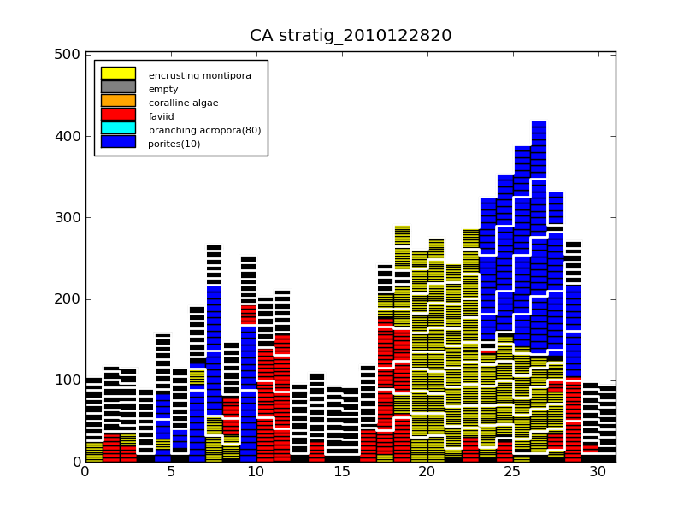
Thickness accumulation over 100 years, in cm. The chrons are at 10 years.
Note: This shows the relief that would be generated, starting from a flat bottom.
Thickness (cm)
Note: Problem to fix – the black box outlines obscure colorations when accumulation is thin.
Years

Slide 5
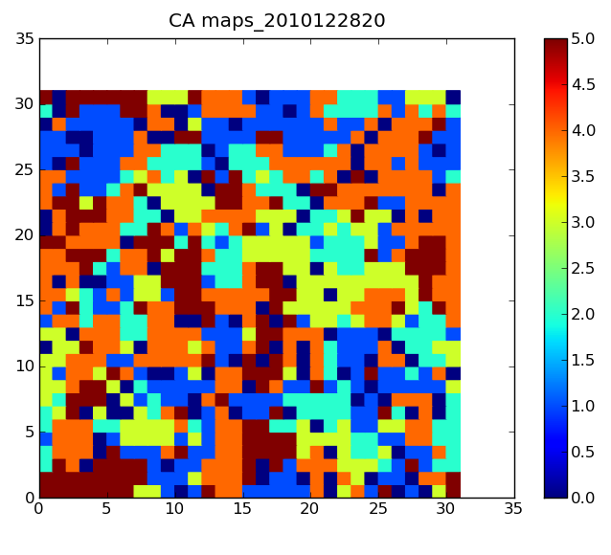
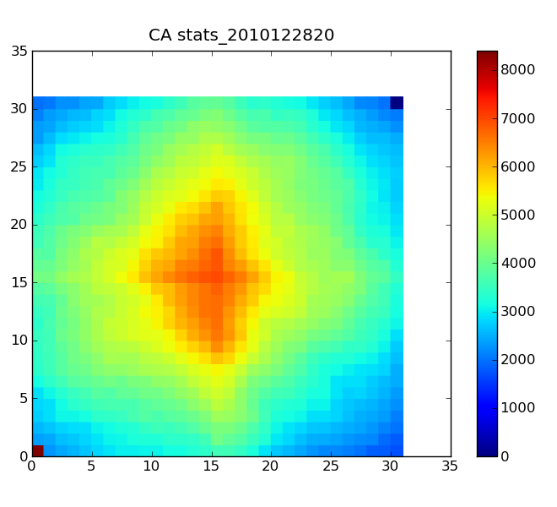
The assemblage at 9 years from random start
Areal coverage and distribution
2D FFT spatial autocorrelation
HiFreq

