Slide 1
pyCarboCat Movies
Burgess RHUL, Jenkins INSTAAR, Potts UCSC, Sarg CSM
Dec 2010

Slide 2
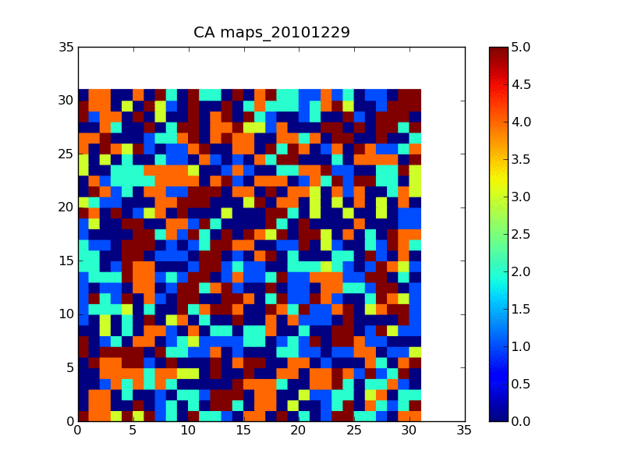
pyCarboCat
Cellular Model
Example
100 frames,
100 years,
5 representative organisms (1-5), and vacancy (0)

Slide 3
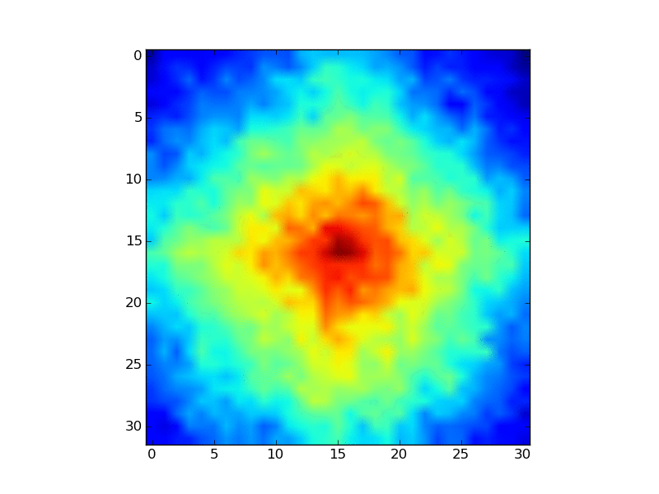
pyCarboCat
CellularAutomaton
Example
100 frames,
100 years,
2D FFT of evolving spatial heterogeneity

